Slide 1
Group Members:
Priyanka Korde
Aniket Singh
Kiran Watole
Project Guide:
Dheerendra Solanki
Face Recognition based attendance management System

Slide 2
Content
Introduction
Objective
AWS Services used
Design of System
Results
Conclusion
Future Scope
References

Slide 3
Introduction
The application shall capture attendance without any manual intervention.
The camera that will capture the images of student and send the images to model.
Then the model will use AWS Rekognition Service to recognize the student’s faces & push the images to S3(Simple Storage Service) for storage and also updates the attendance automatically in a database.
Build a web-based dashboard to visualize all the student’s attendance information.

Slide 4
Objective
The purpose of the attendance management system is to help the administrators keep a track of students .
Automated attendance management software can help administrators save time and money.
Such a system also reduces staff workload and increases efficiency.

Slide 5
AWS services used
AWS Rekognition
AWS Lambda
API Gateway
AWS DynamoDB
Amazon S3
Amazon SNS

Slide 6
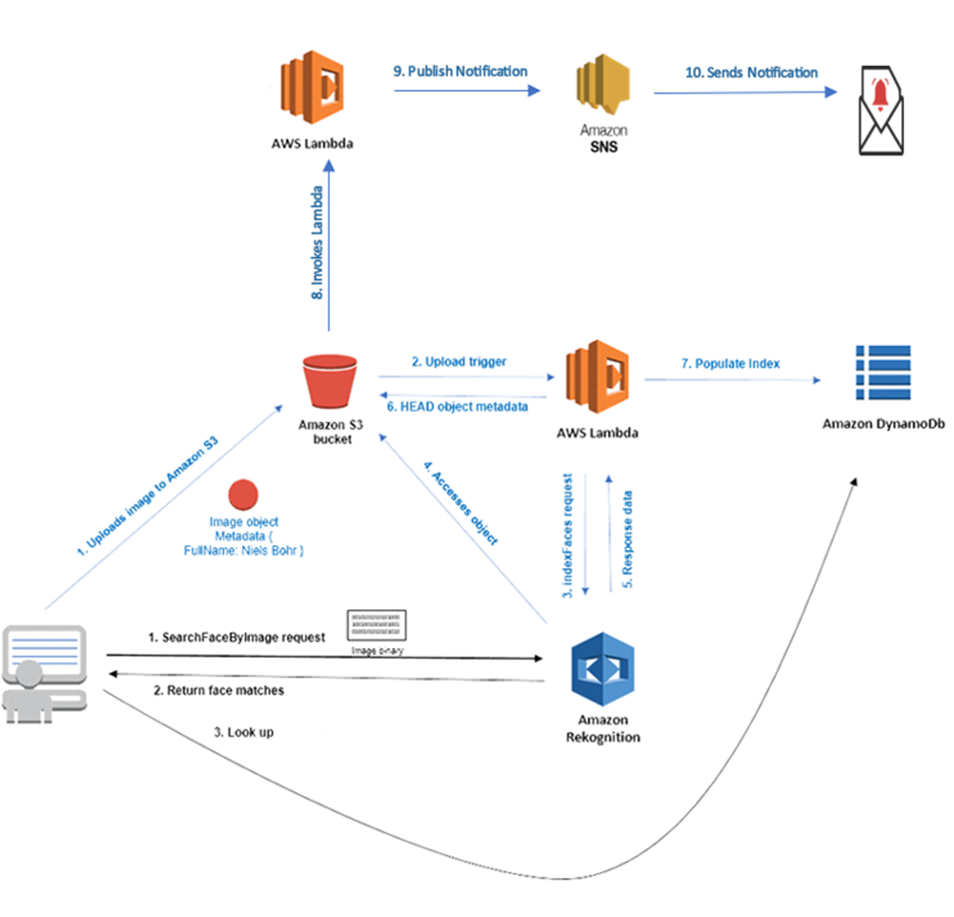
Design of the System

Slide 7
Conclusion
The system has demonstrated the potential to change traditional attendance tracking methods by utilizing Amazon Rekognition for facial recognition capabilities, AWS Lambda for serverless computing, and AWS S3 for image storage.
As a result, our project primarily focused on tracking attendance for various use cases such as the office, events, schools, and colleges, among others.
Thus we created an easy-to-use web page and ended the project via email to validate attendance.

Slide 8
Future scope
There is a very broad future of Face Recognition system using AWS services as we can use much more innovative ideas to improvise the current project.
Like just by automating the model train with the labels of Amazon Rekognition service looping the codes, this could be done by using the service Amazon sagemaker.
Making an easy to use User Interface for the end users to make the process more easy.
Also for various departments and perspective of the project we can innovatively use other services and get the outcome as per the requirements for the same.

Slide 9
References
https://github.com/CriMenio/Face-Detection-Attendance-Management-System/tree/main
https://docs.aws.amazon.com/apigateway/latest/developerguide/set-up-lambda-proxy-integrations.html#apigateway-multivalue-headers-and-parameters
https://docs.aws.amazon.com/apigateway/latest/developerguide/how-to-integration-settings.html
https://www.youtube.com/watch?v=zLL4ZTmDHSI

Slide 10
ThankYou😇👋

